Slide 1
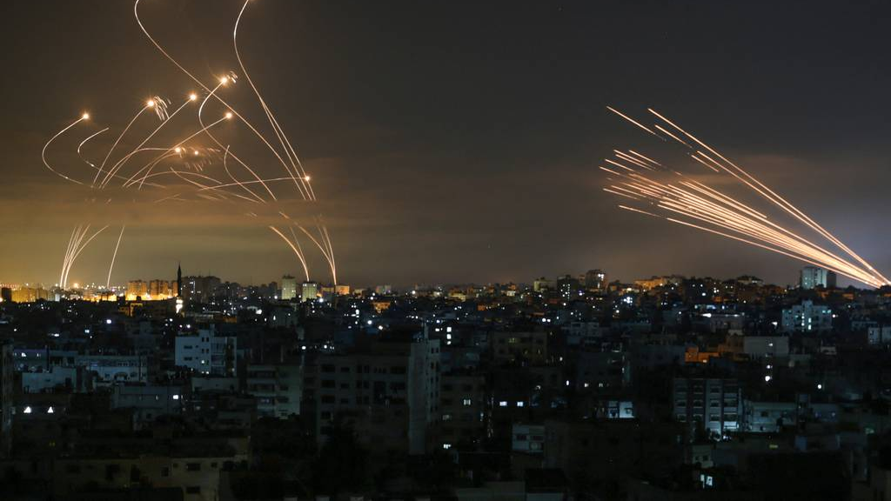
The Steel Hemisphere
A Projectile Interception system
Jacob Khalili (EE), Tyler Pelayo (EE), David Stekol (EE), & Joseph Sutton (ME)
Advisors: Prof. Rosen, Prof. Kirtman, Prof. Sable
Technical Advisor: Mike Giglia

Slide 2
Background Research
Missile Defense systems are rapidly becoming an interest for many nations worldwide
Several systems have already been produced namely:
The Iron Dome, THAAD system, Patriot system, David’s Sling
This presents an opportunity for a useful and compelling dynamics demonstration.

Slide 3
OUR Mission
Building a model projectile interception system that can be used as a workshop demonstration to teach Dynamics to future Cooper Union students.

Slide 4

Scope
A contraption capable of tracking and intercepting a gently tossed object from different places with different trajectories within a Cooper Union classroom that can be used as a Dynamics demonstration.

Slide 5

Relevant Dynamics Topics
Projectile motion
Impulse
Conservation of Linear momentum
Potentially drag, buoyancy, and more

Slide 6
Necessary components for success
A precise position & velocity tracking system
A program for predicting a flight path
A program for choosing an acceptable intercept point
A process keeping track of timing
STAGE 1
STAGE 2
STAGE 3
STAGE 4
A mechanism for launching an object at a repeatable speed and trajectory
A mechanism to orient the launcher to the prescribed direction
A process for relaying instructions to launcher
A program for determining what launch conditions are needed to reach the intercept point

Slide 7
Projected timeline
October
Complete command to fire system.
November
Make platform fire consistently at fixed angle target.
December
Finish controls for tilt/rotation.
January
Complete auto honing to fixed target.
February
Complete auto honing to multiple fixed targets.
March
Complete auto hone to target dropped at fixed location.
April
Complete auto hone to target thrown at nontrivial angle.
May
Prepare public test environment/demo.

Slide 8
Estimated costs
Item | Cost | Notes
Stereo Vision System | $500 | Pre-synced, 120 FPS, available at https://www.stereolabs.com/
Launch mechanism | $200 | Beefed up Nerf Blaster
Launch Orientation System | $100 | Servos! Robotics!
Computation System | Available from CU
500 Foam Spheres | $33 | Easy to launch, aerodynamic, available on Amazon
TOTAL | $833

Slide 9
Thank You!

Slide 10
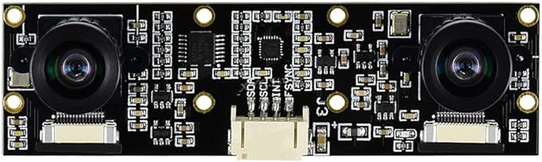
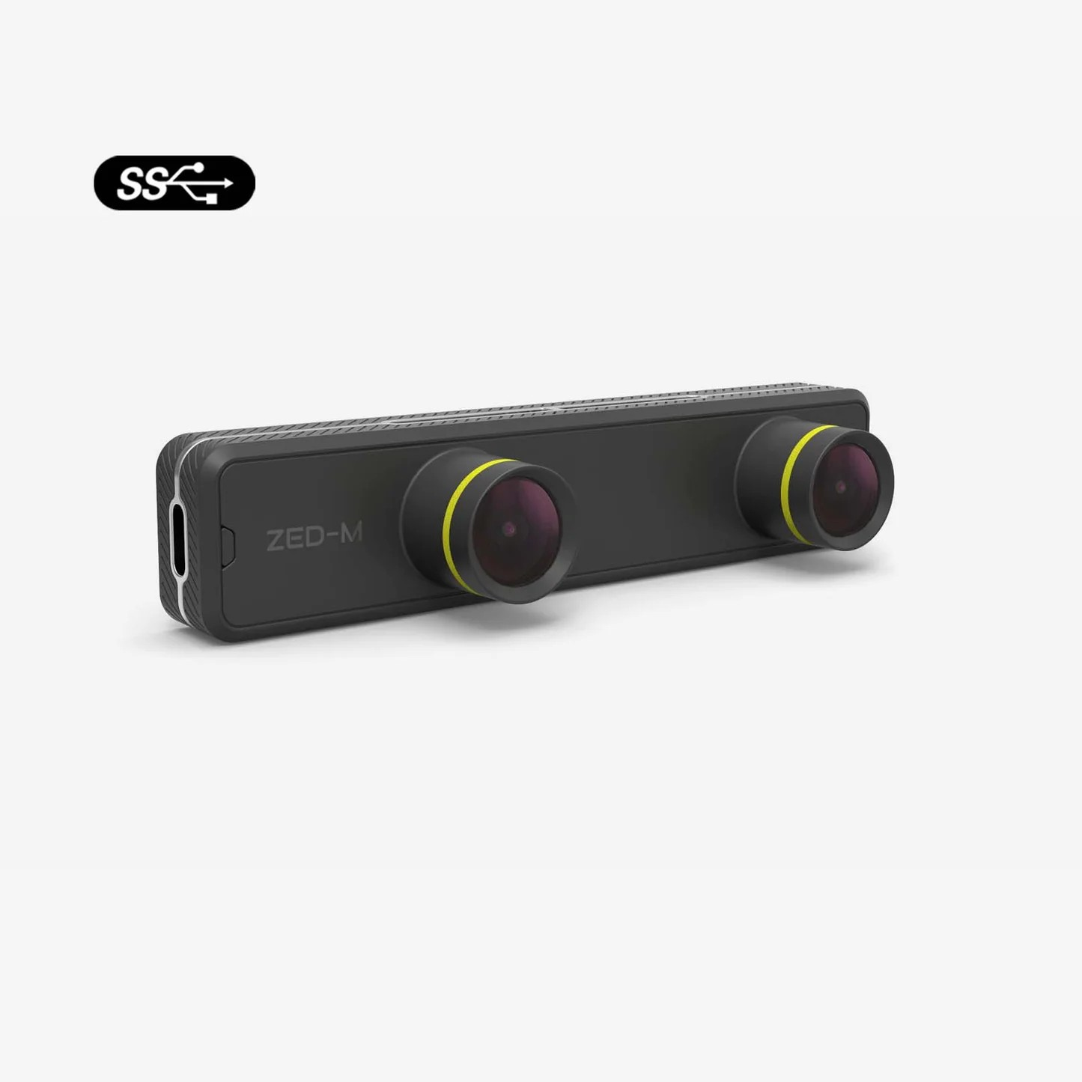
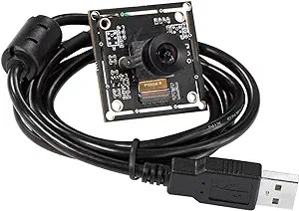
Vision System

Slide 11
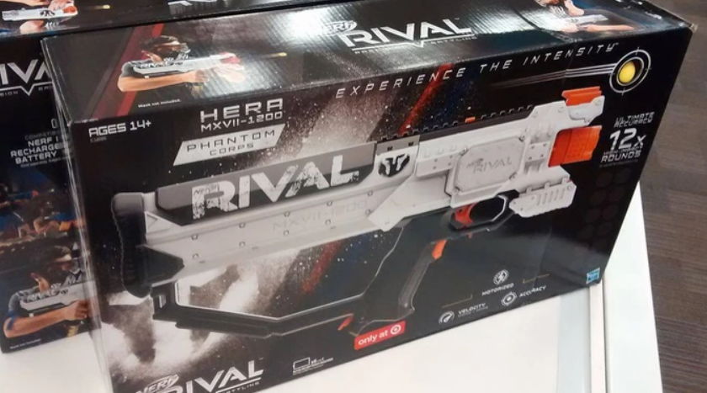
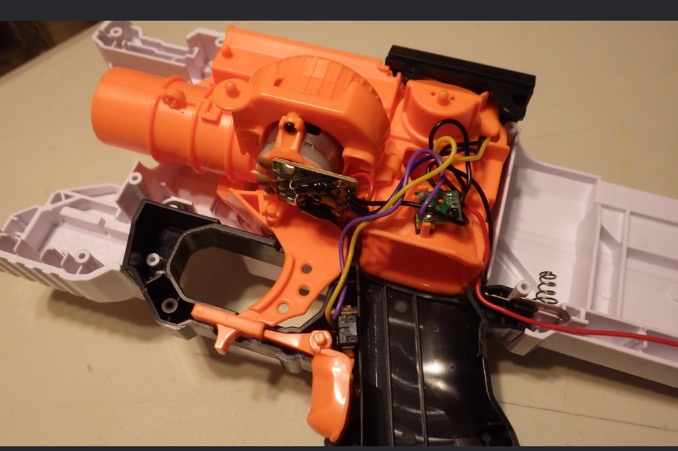
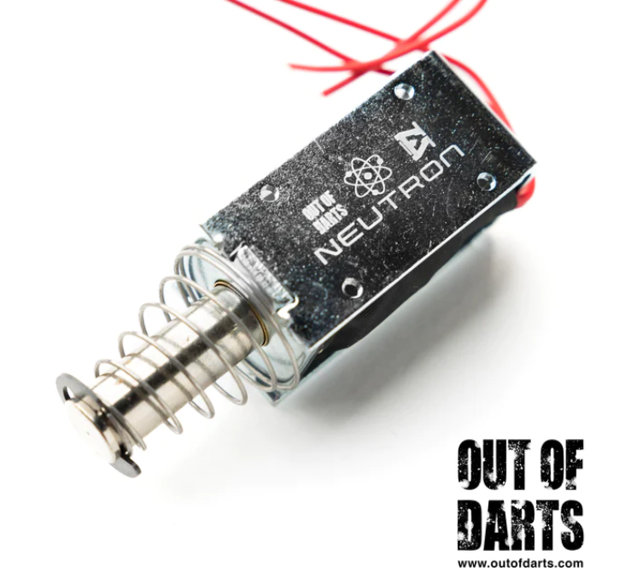
Launch System

